Slide 1
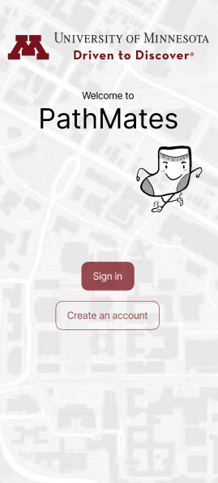
Pathmates
Group- 8
Notes:
https://www.canva.com/design/DAGYLgoI3mw/CWl_SK63LP1xXE3ONnpSKA/edit?utm_content=DAGYLgoI3mw&utm_campaign=designshare&utm_medium=link2&utm_source=sharebutton

Slide 2
PathMates is designed to pair UMN students with each other to walk together.

Slide 3
Objective
Our App aims to do the following:
Enhance UMN campus safety for student pedestrians.
Encourage community based space for students to make new connections.

Slide 4
Our Prototype (Link to Figma)

Slide 5
Changes [1]
Removed U-Card verification as the app verified students via Duo. (Cognitive walkthrough)
Mascot guides the user through the entire sign-in process. (Heuristic #10 Help and Documentation)
Made the user list more visible by showing a preview of it. (Cognitive walkthrough and Heuristic #9 Aesthetic and Minimalist Design)
Indicated to the user that their location is not visible for privacy concerns. (Paper Prototyping)

Slide 6
Changes [2]
Change the order of matching and messaging the user, indicating to the user that they need to message first to coordinate walk. (Preliminary User test)
Added more confirmation buttons and screens. (Cognitive walkthrough and Heuristic #6 Error prevention)
Removed emergency button because it struck fear in user. (User Testing)

Slide 7
Questions?

